Slide 1
CHANDRA rates update

Slide 2
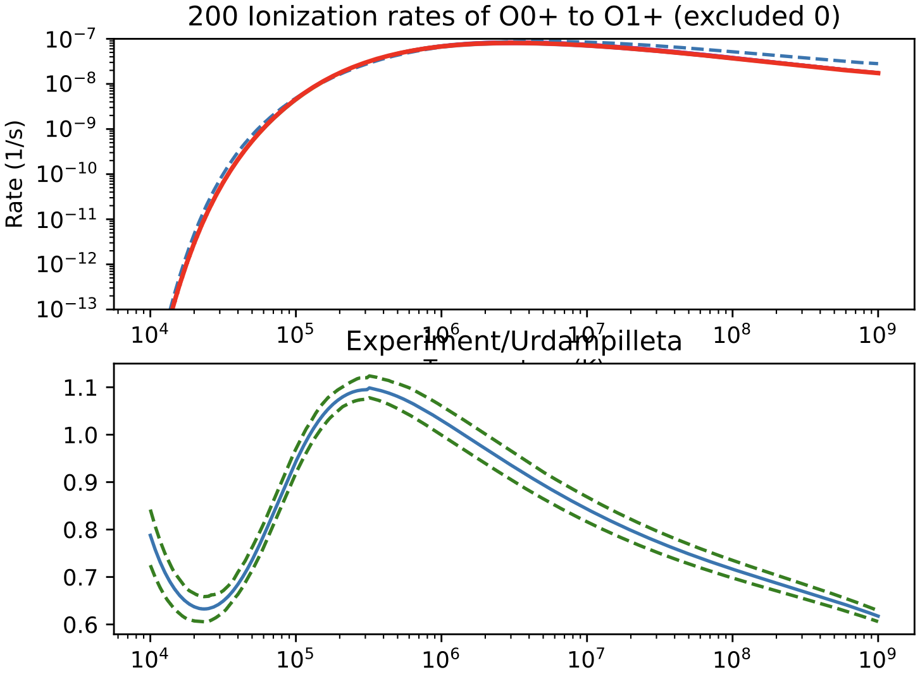
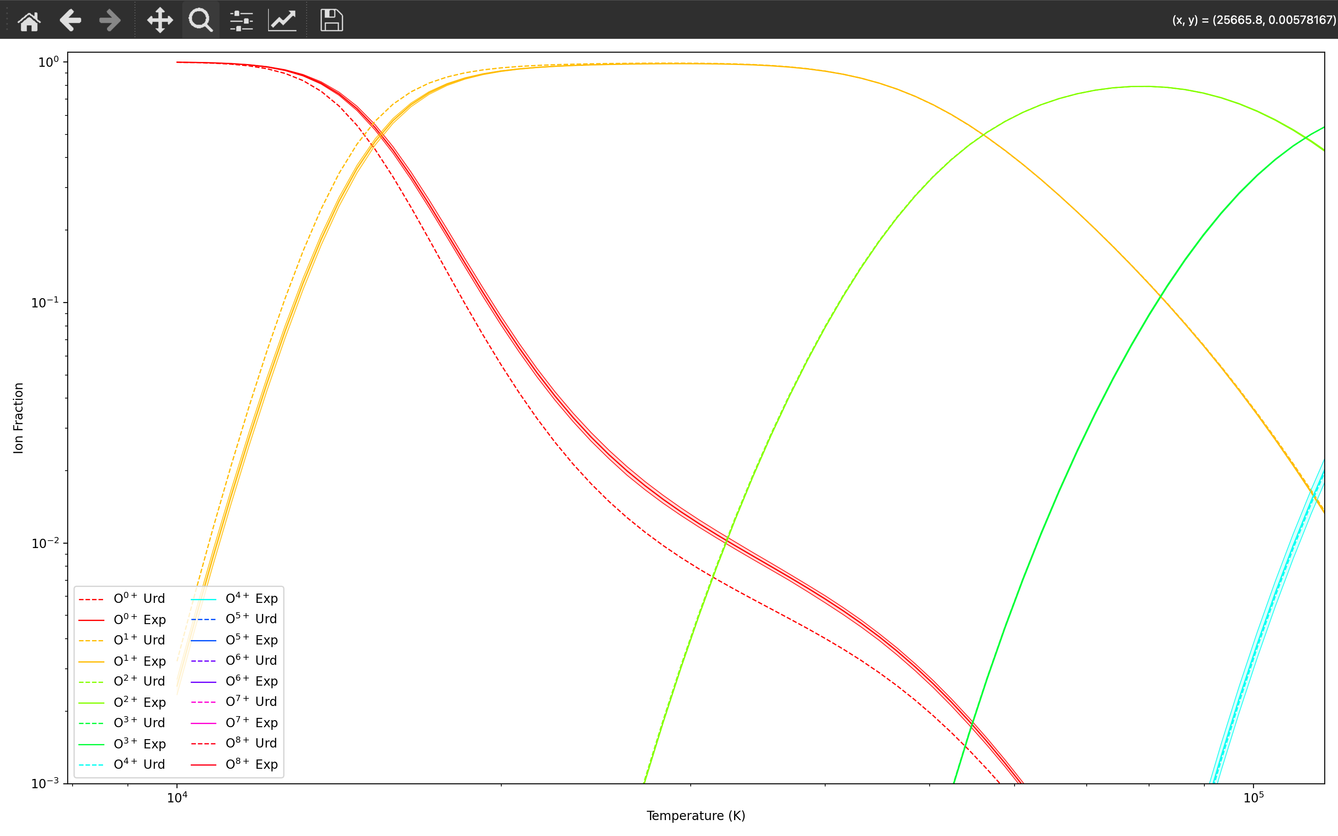
O -> O1+: nothing stated in Urdampilleta 2017
Red = neutral O
Orange = O1+

Slide 3
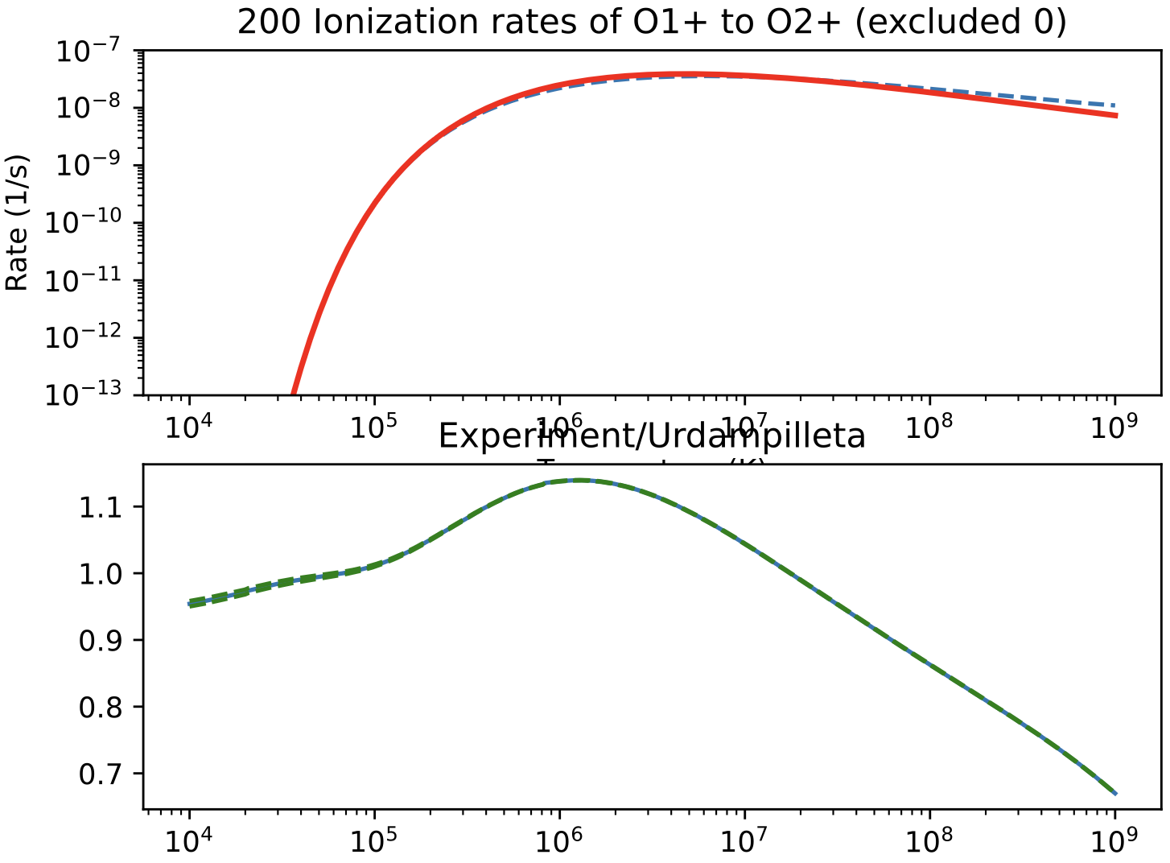
O1+ -> O2+: I use results from 2013, Urd doesn’t mention this source and uses data from 1971 and 1989
Red = neutral O
Orange = O1+

Slide 4
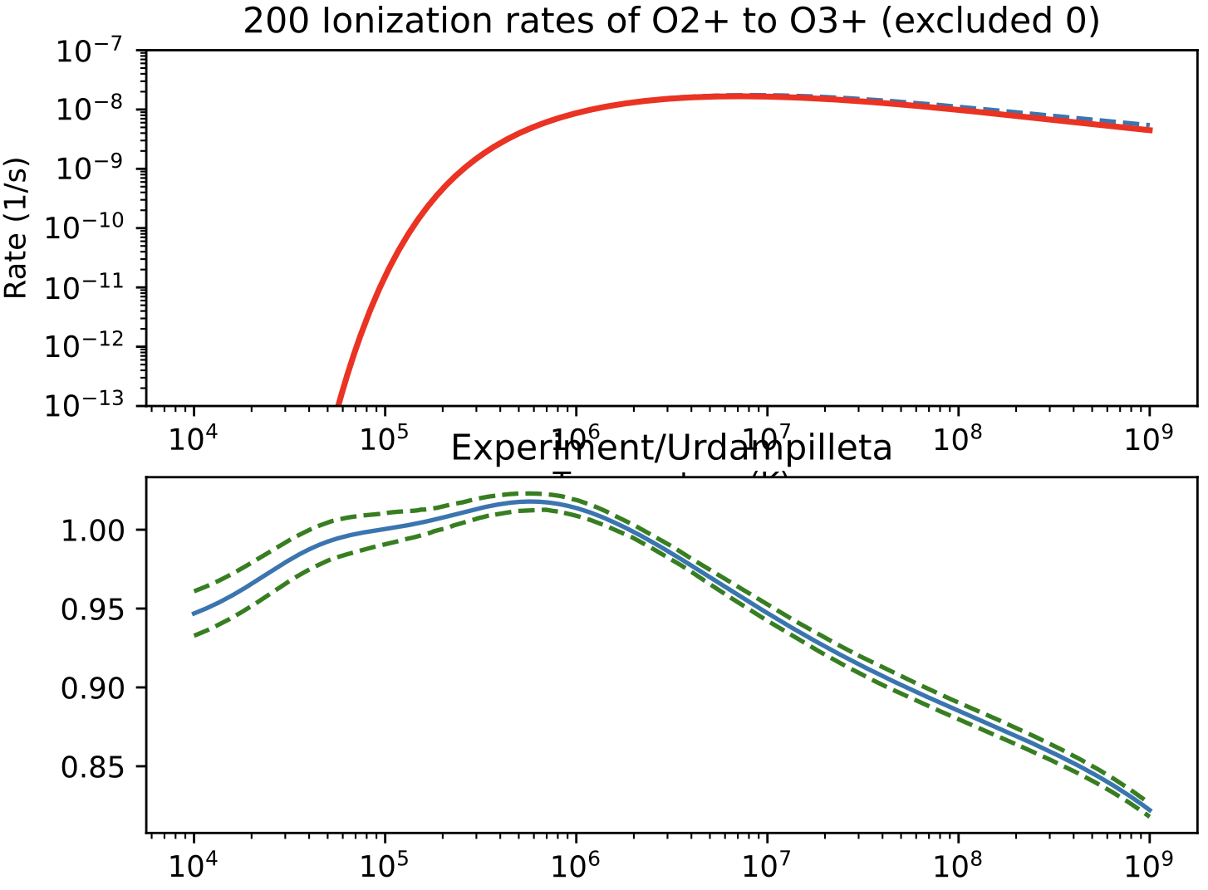
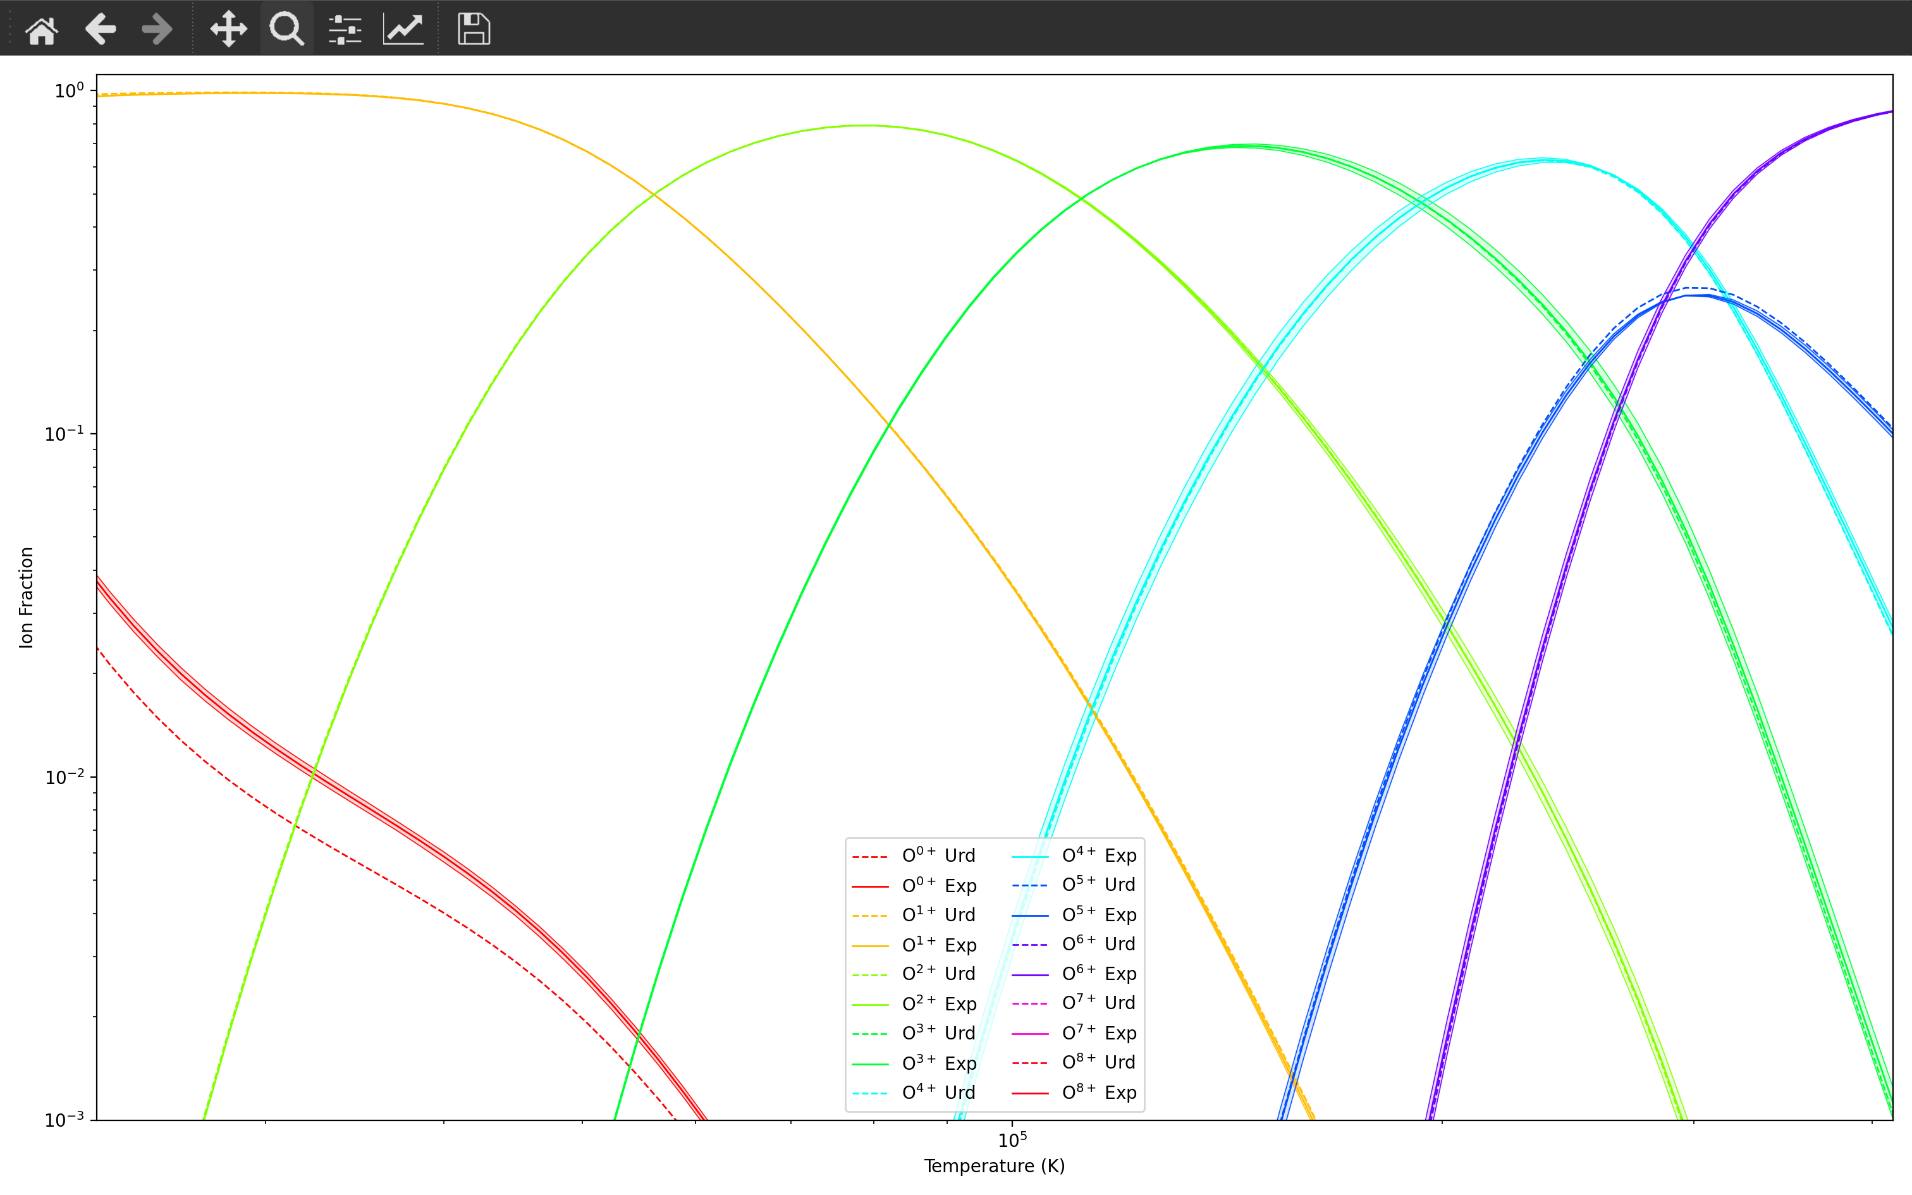
O2+ -> O3+: Urd uses a combination of three experiments, but the ion fraction is basically identical.

Slide 5
O4+ -> O5+

Slide 6
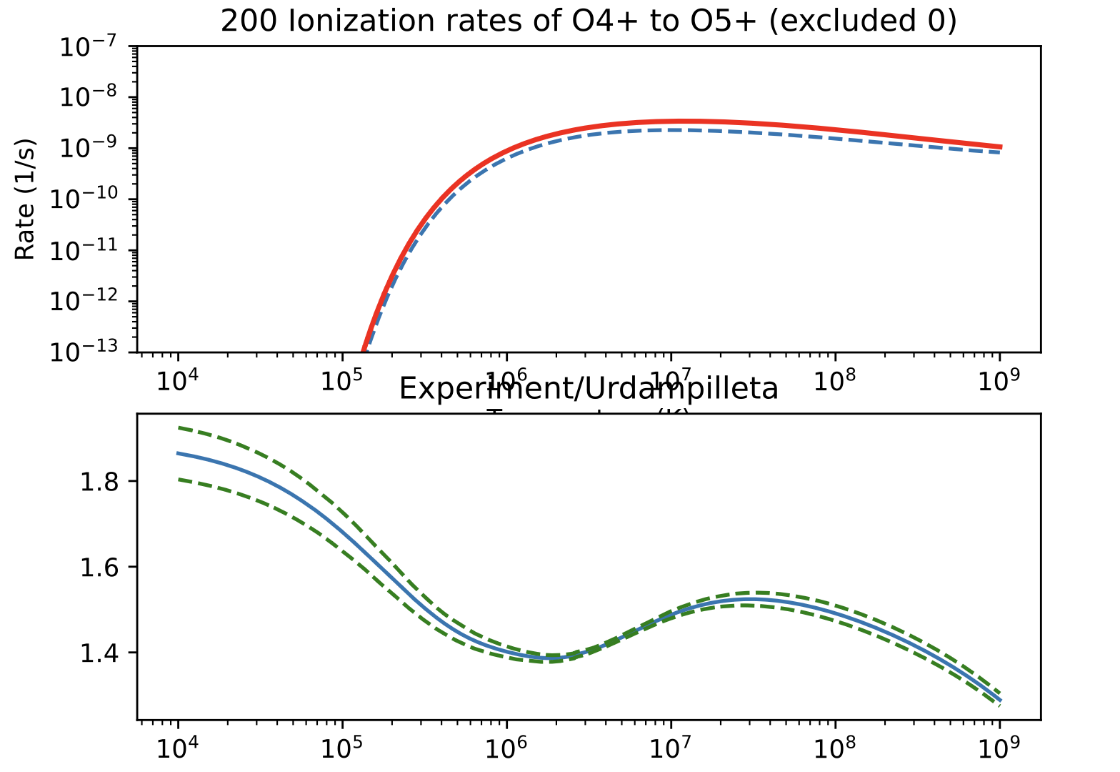
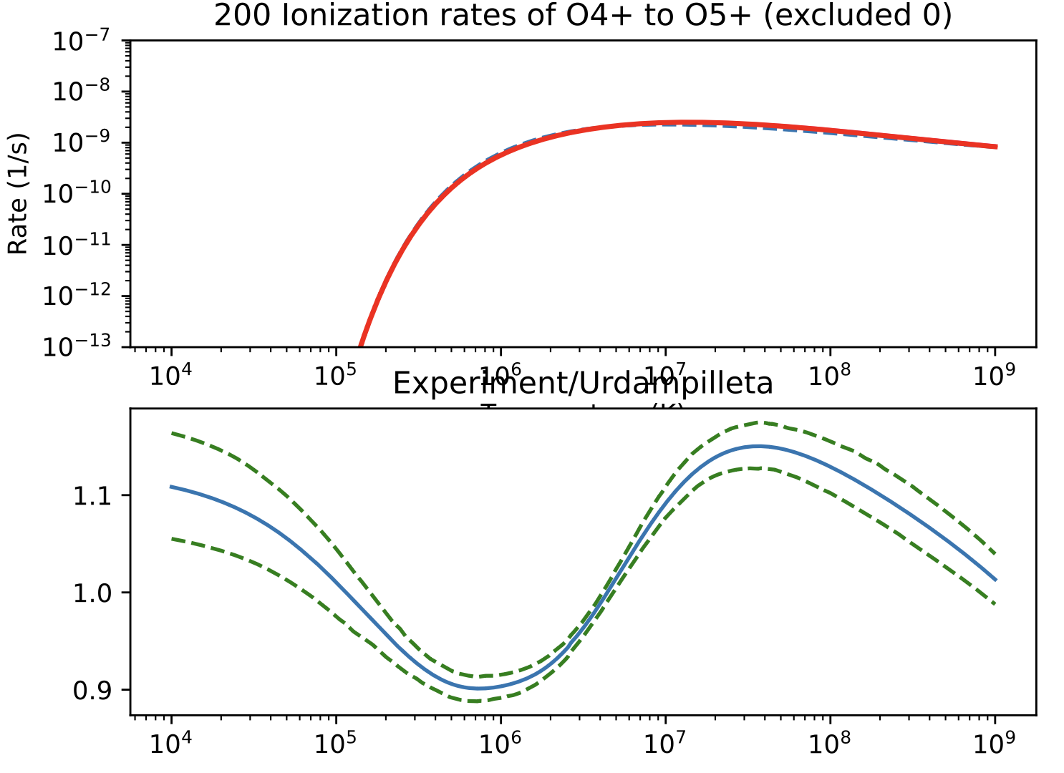
Metastables are a big problem here. You can infer the GS cross sections provided you can
Accurately measure the metastable fraction
2. Significantly change the metastable fraction and remeasure cross sections.
Urdampilleta found a source not in the NIFS database which doesn’t fully account for metastables but has a much lower metastable fraction (90% -> 24%)
Old source
Same source as Urd.

Slide 7
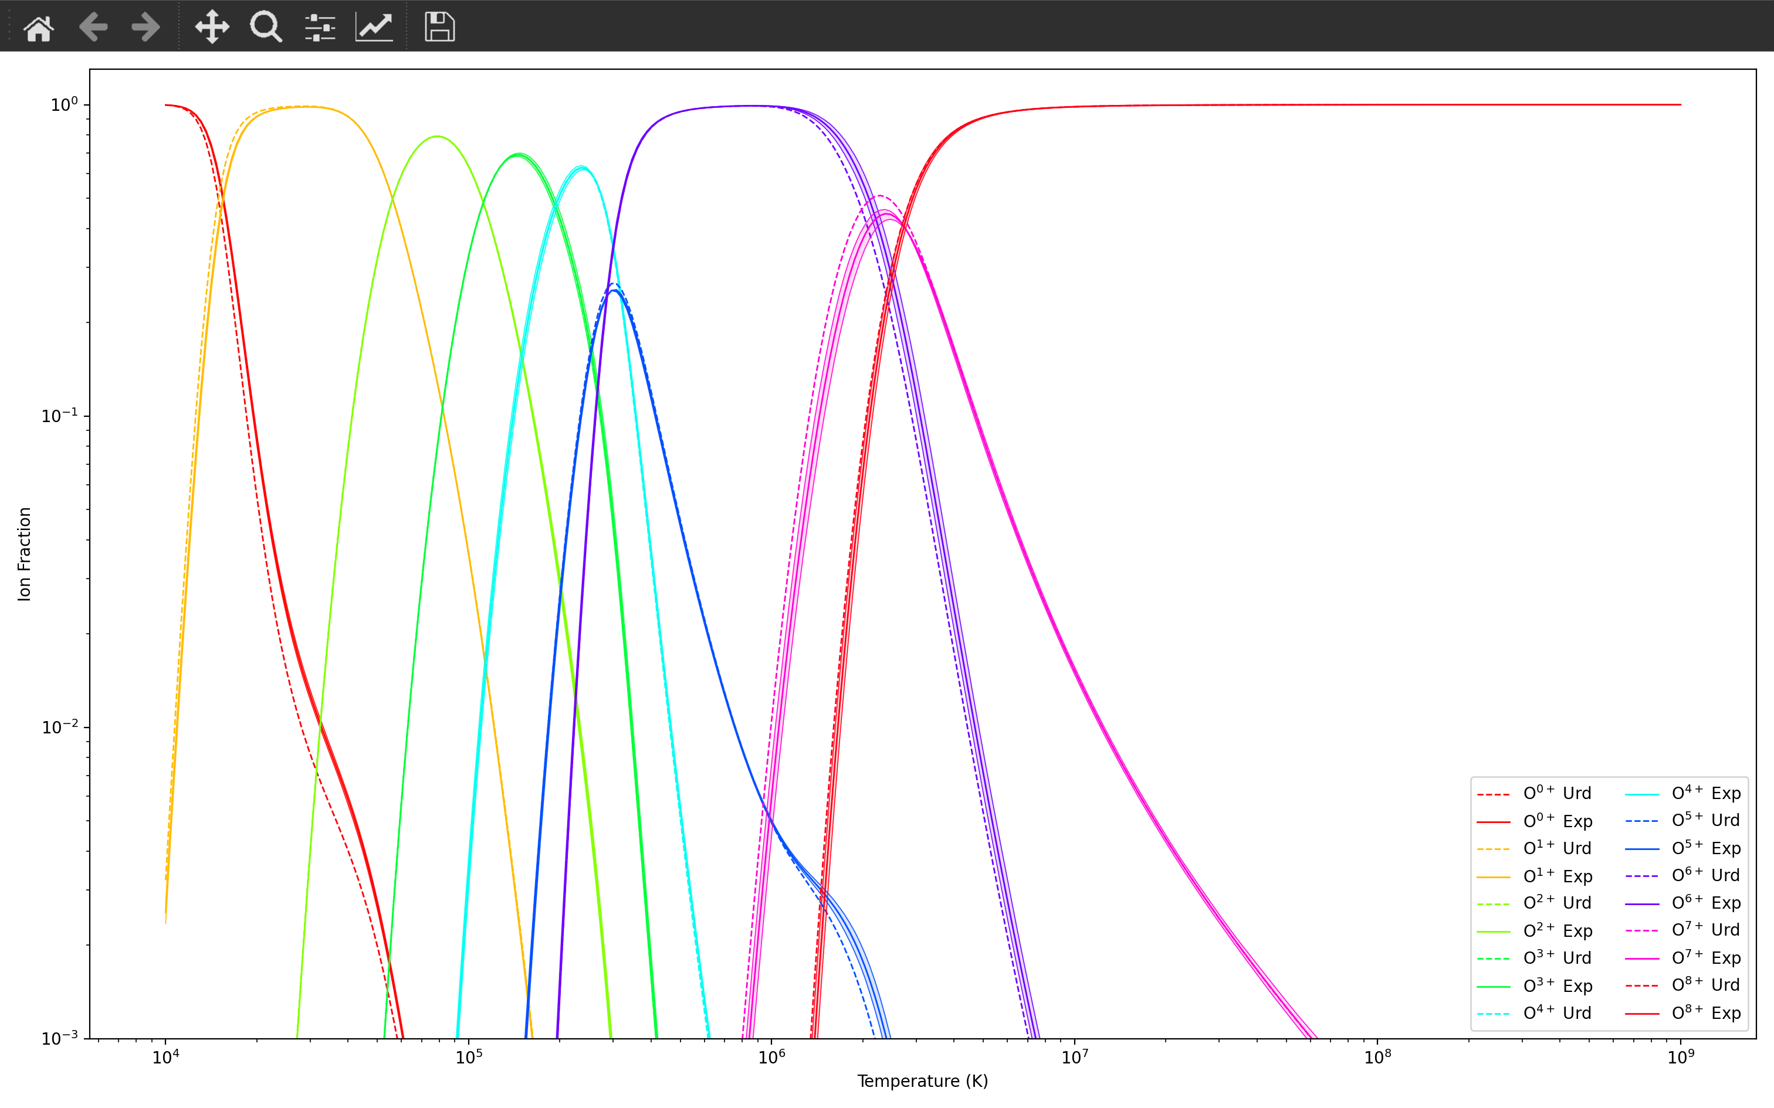

Slide 8
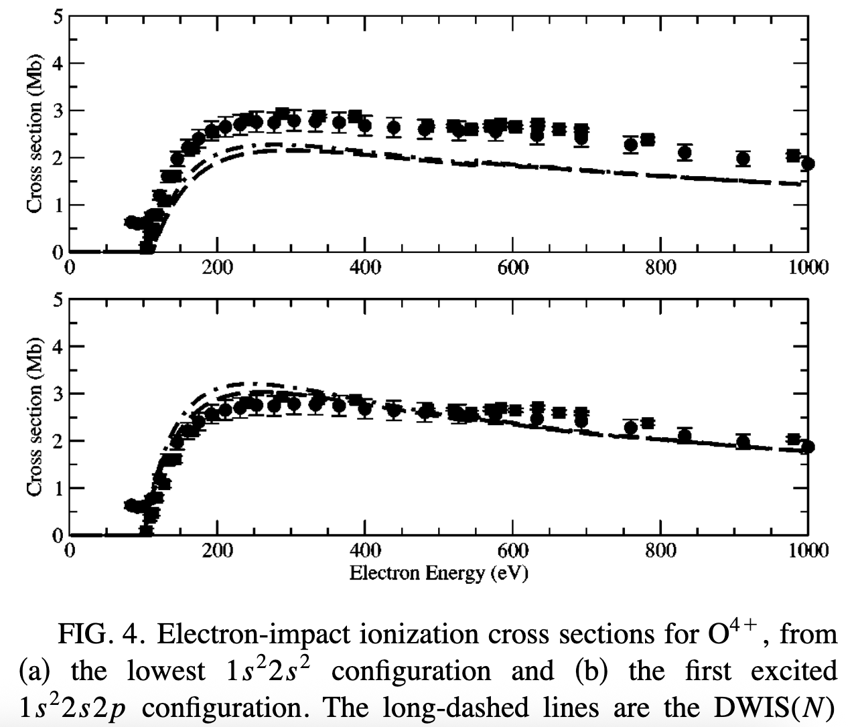
Slide of shame

Slide 9
O5+ -> O6+

Slide 10
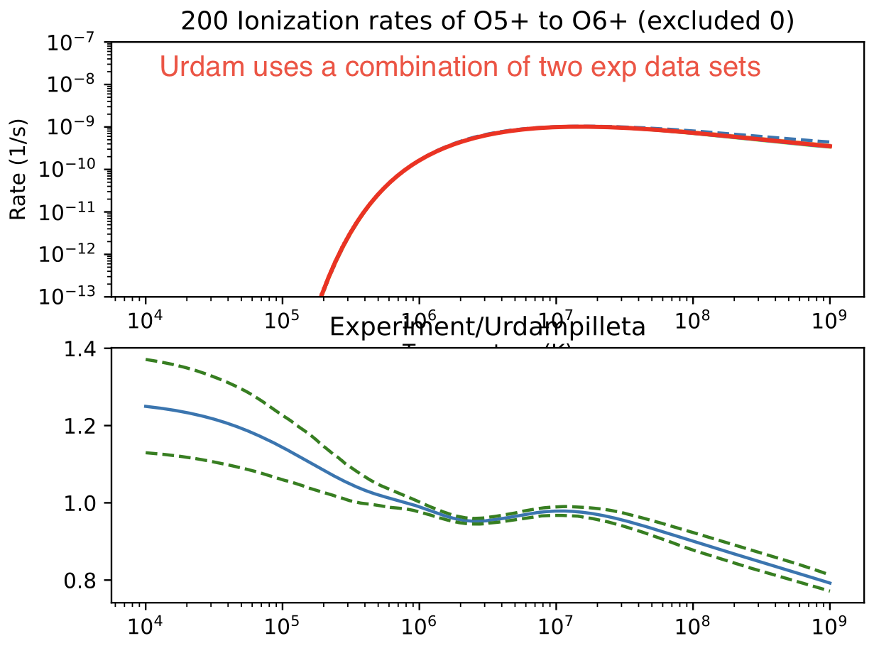
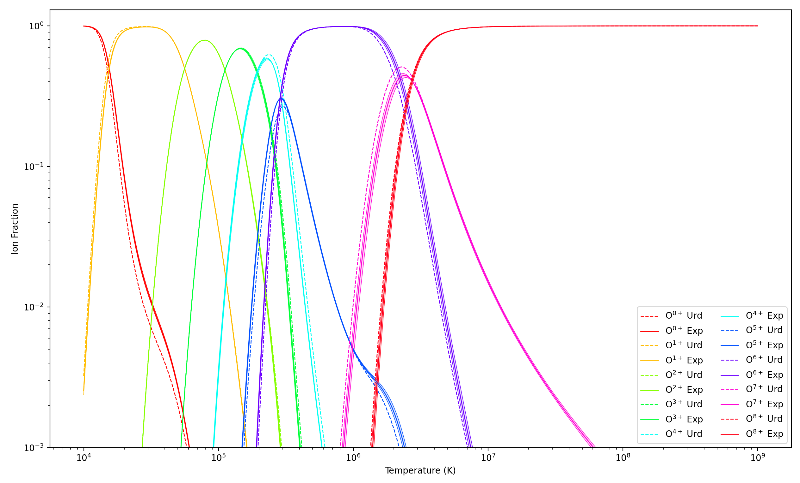
1986 Crandall O5+

Slide 11
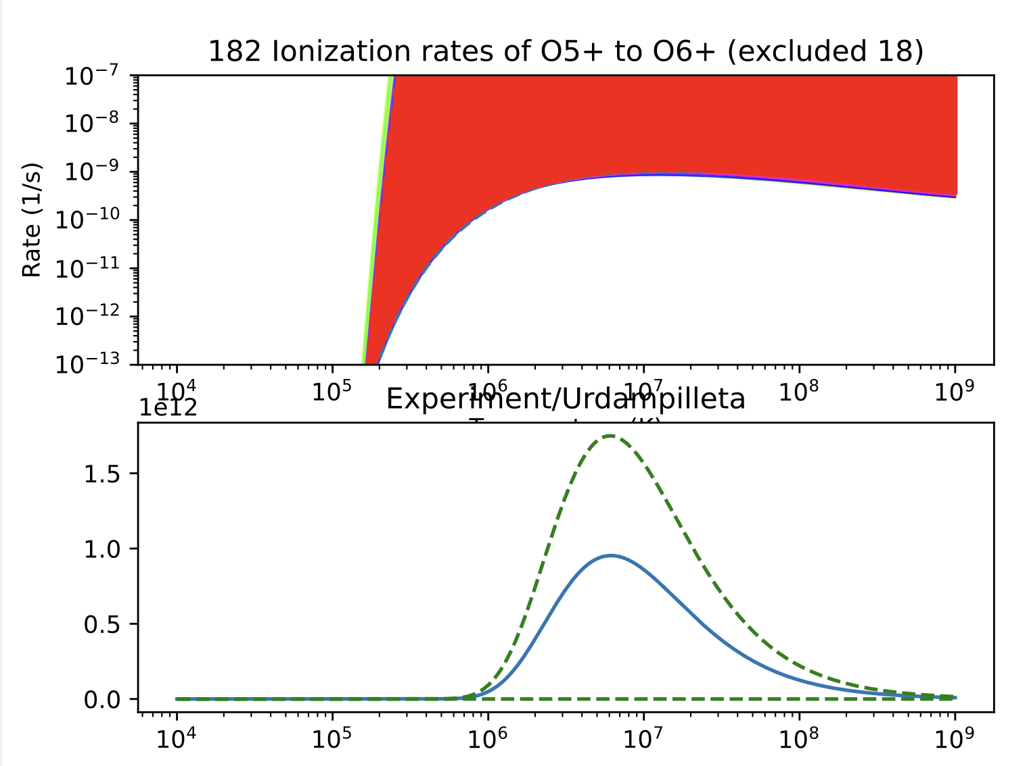
Using Defrance 1990, which doesn’t have enough data points at high E

Slide 12
O6+ -> O7+

Slide 13
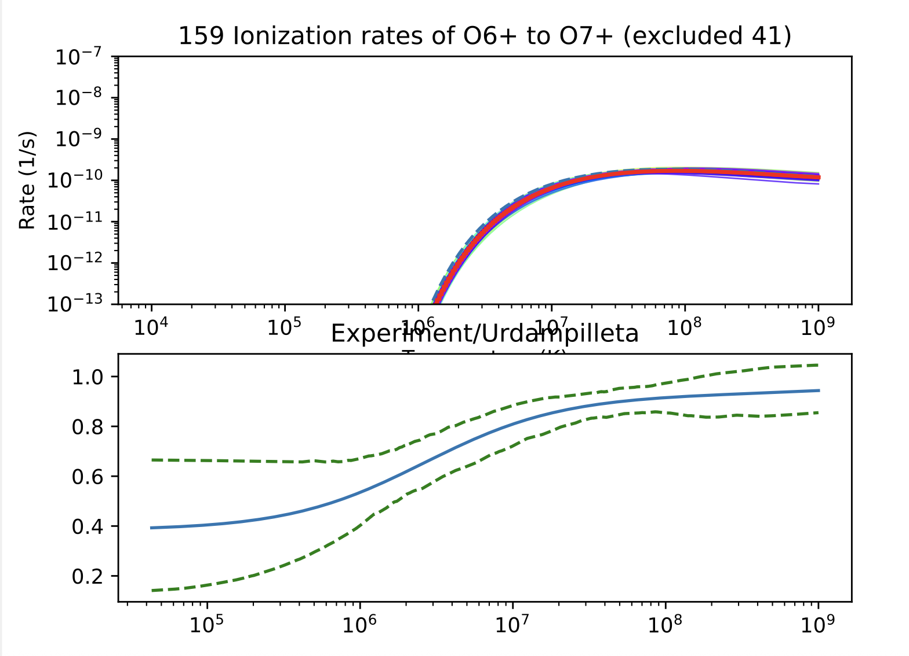
Urdam uses theoretical calculations, which do not agree with experiments at low temperatures

Slide 14
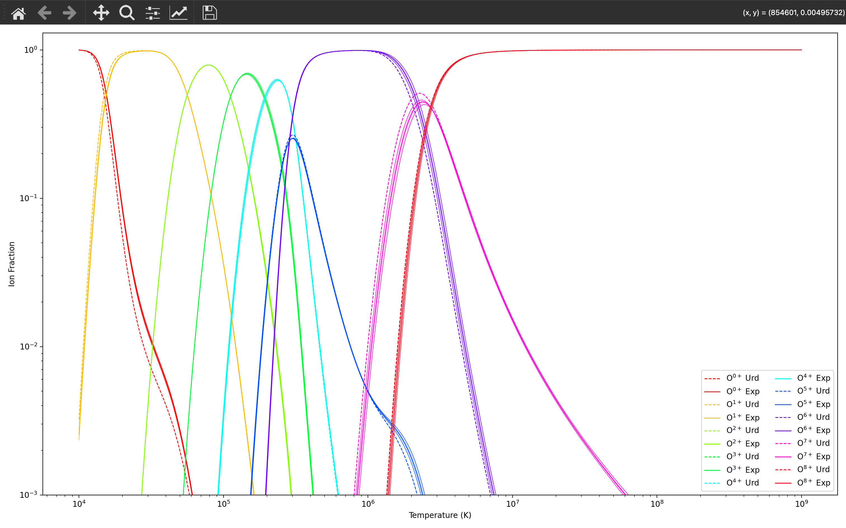

Slide 15
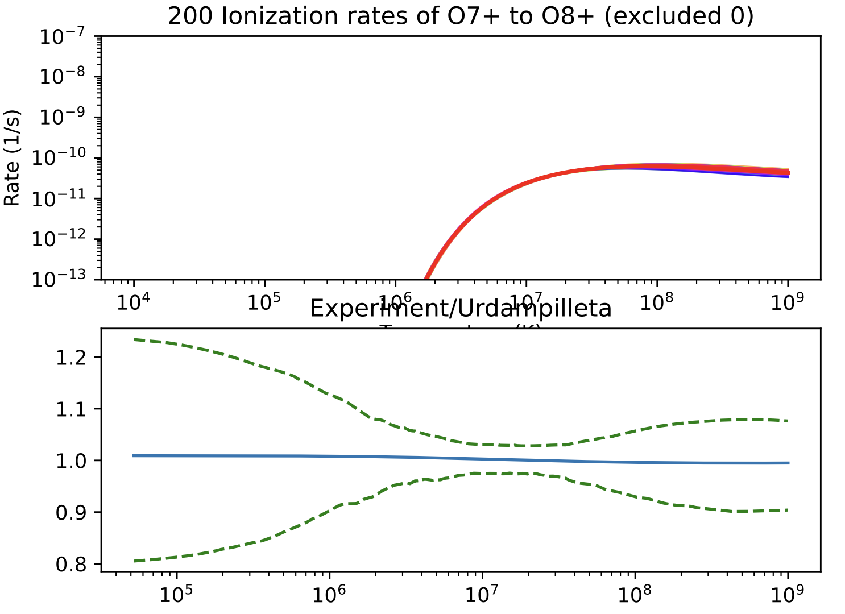
O7+ -> O8+
Great agreement (same source) for rates, but ion fraction diverges (next slide)

Slide 16
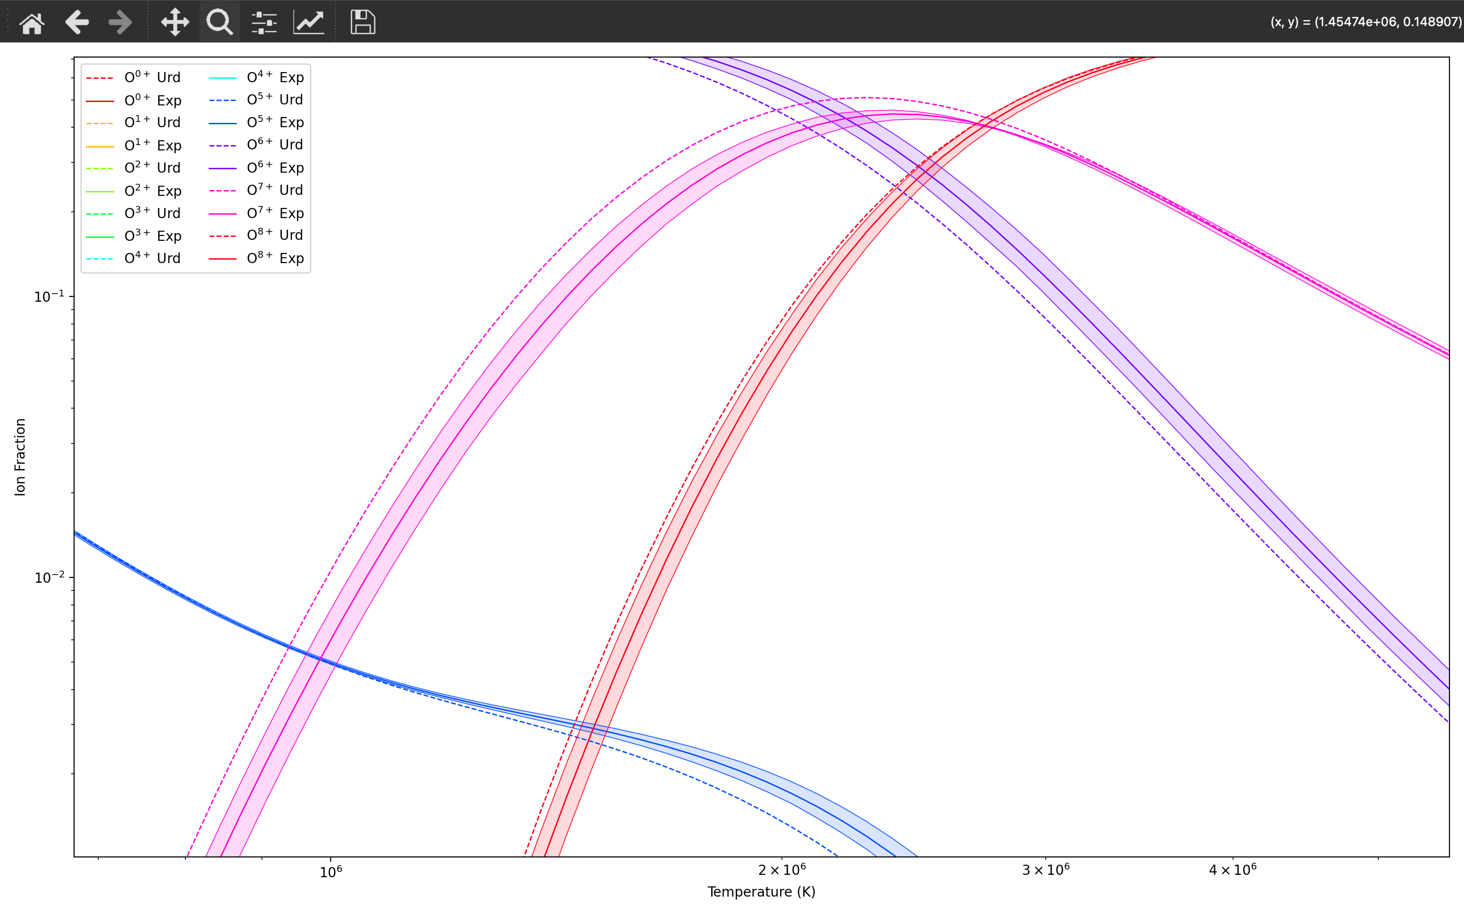
Disagreement for O6+ and O7+ ion fraction

Slide 17
Conclusion
Still need to see how the ion balance affects real spectra (e.g., XRISM?)
Need to investigate disagreement from O6+ (why is theory so different?)

